Slide 1
Digital portfolio
Name:Akasthiya. P
Register. No and nmid: 24131060500122007 and
FA01CC9DA7B287882824AC8C3295C556
Department: bca II-year
College: shree Raghvendra arts and science college, keezhamoongiladi, Chidambaram

Slide 2
Project title
Digital portfolio using HTML, CSS and JavaScript.

Slide 3
Agenda :
Problem statement
Project overview
End users
Tools and technologies
Portfolio design and layout
Features and Functionality
Results and screenshot
Conclusion
GitHub link

Slide 4
Problem statement
the digital portfolio that effectively showcase on individual skills and experience achieve is a Visually appealing and interactive way ,while also Being easy to maintain and update.

Slide 5
Key Challenges for portfolio
Showing complex information
Designing and Engaging interface
Maintaining and Updating content
Ensuring Accessibility

Slide 6
Project overview
Project description:
A digital portfolio is a We based Platform That showcase on individual ,skill, experience and Achievement
In a Visually appealing And interactive way.

Slide 7
Who are the end users?
Potential end users :
Employees, clients, Colleges and peers, Industry professional
2.Goals of end users :
Accessing Skills and experience, Evaluating Work quality, identifying potential collaborator
3.Designing for end users :
Clear navigation, Relevant content, Easy-to-use interface

Slide 8
Tools for portfolio
HTML: Structuring content ,creating page, Adding multimedia
CSS : Styling and layout, creating responsive design
JavaScript : Adding interactivity, Create dynamic content

Slide 9
Technologies for portfolio
HTML: Semantic HTML, accessible HTML.
CSS: responsive design, flex box and grid.
JavaScript: Event handling, Image galleries.

Slide 10
Portfolio design
Simple and student-friendly UI: Clean layout and bright , friendly color ( eg : Orange).
Readable typography :use easy to read Fonts like arial of clarity .
Profile photo and icons: include a photo and icons for section like Project or contact .

Slide 11
Layout for portfolio
Header: Student name, course an a short tagline .
About Me: personal intro, academic background, Skills summary .
Contact section: Email, Phone number, Optional form or LinkedIn/ GitHub link.

Slide 12
Features for portfolio
Responsive design: Accessible on various devices.
Project showcase: Display project with images.
Interactive Element: Hover effects And scrolling effects.
Navigation menu: Easy access to different section.

Slide 13
Functionalities for portfolio
Smooth transition: Smooth transition between pages or section.
Scrolling effects: Scrolling effects to enhance user engagement.
Contact form: Functional contact from for user enquiries.
Case studies: include case studies or detailed project analysis.

Slide 14
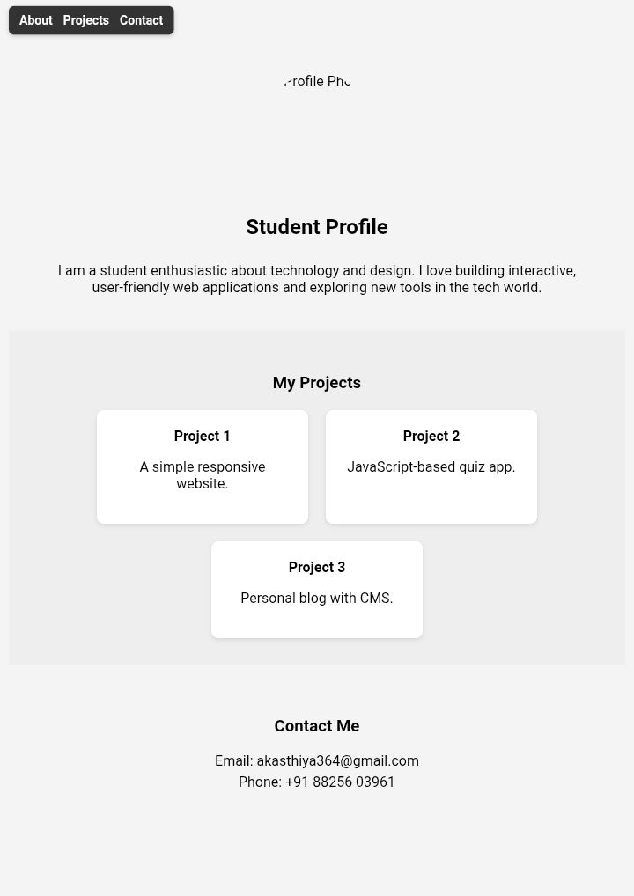
Results and screenshots

Slide 15
Conclusion
A strong conclusion for a digital portfolio effectively summarizes, skills, experience and achievements
While reiterating my goals and leaving a Lasting Impression On the viewer

